Slide 1

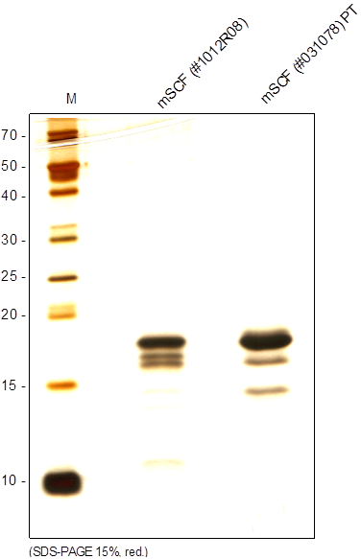
Reliatech GmbH
Recombinant mouse SCF
(Cat #M30-010 / M30-011)
Fig. 1: SDS-PAGE analysis of recombinant mouse SCF derived from E. coli. Samples were loaded in 15% SDS-polyacrylamide gel under reducing conditions and stained with Silver stain.
http://www.reliatech.de / orders@reliatech.de

